Slide 1
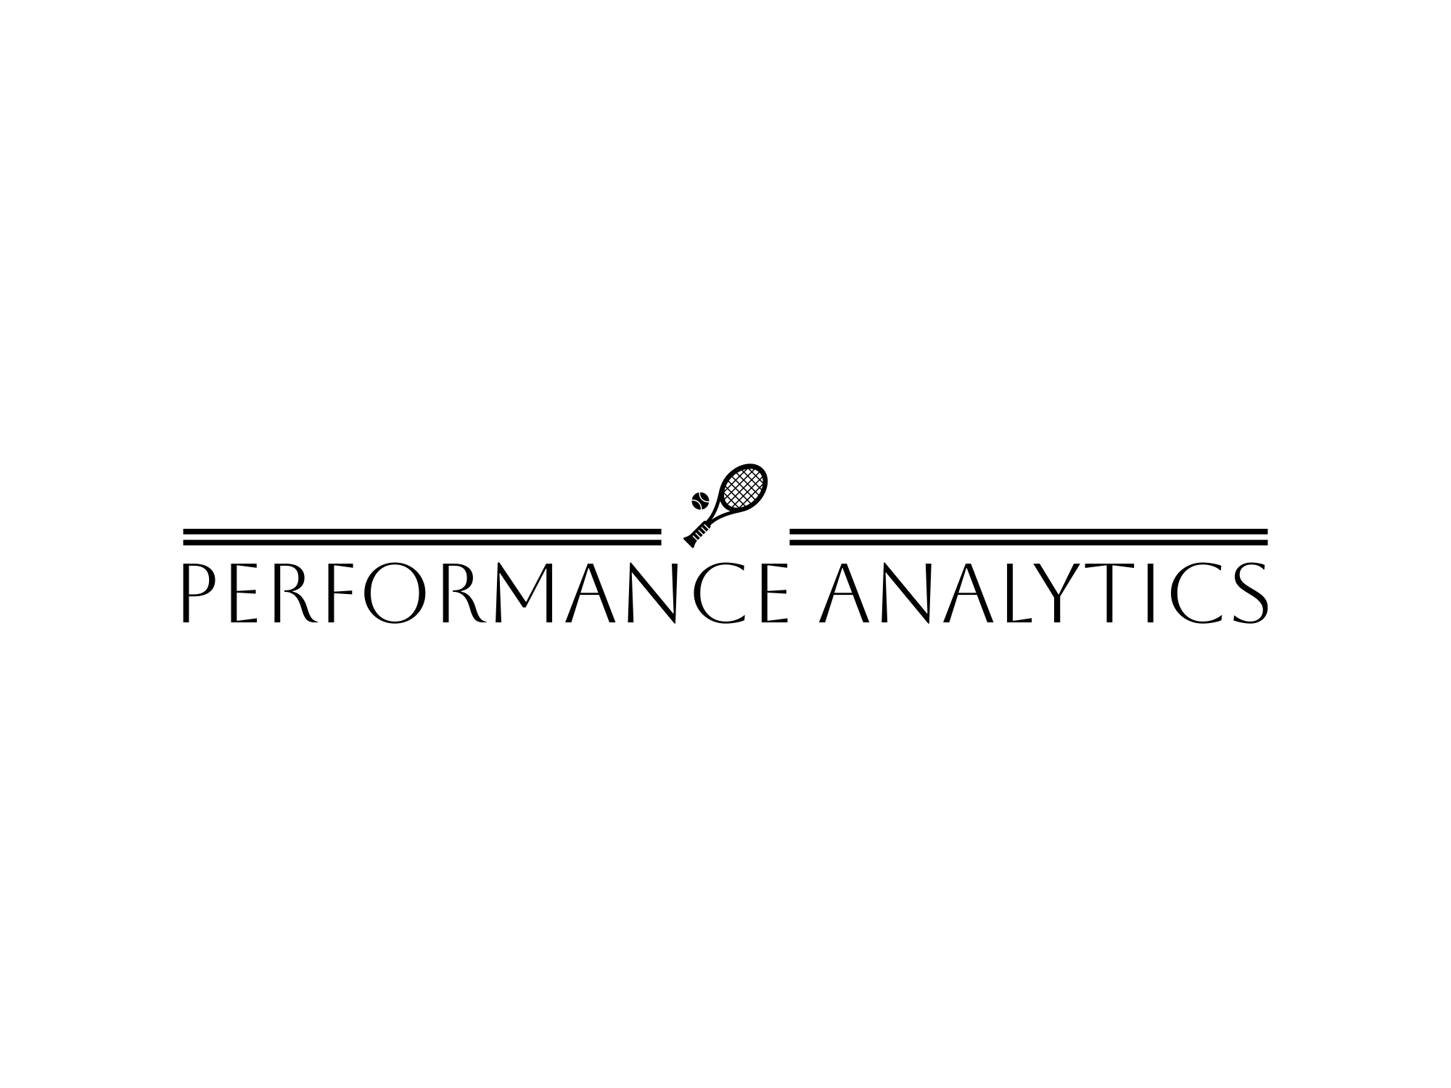
Tennis Video Analysis Using Python ML & AI
2024 MSBA & Performance Analytics
Team
Phillip Beagley, Rebeca Escobar, Sebastian Peterson, Jisung Woo, Ling Smith

Slide 2
Agenda
Project Overview
Key Challenges
Early Milestones
Project Scope & Alignment
Results: Data Preparation
Results: Video Augmentation
Business Insight & Next Steps!

Slide 3
Project Overview
Goals for transforming performance using computer vision & analytics
The goal for the entire project is to create an End-to-End Data Product that will help a tennis player/coach determine optimal strategies, point out strengths & weaknesses to provide strategic corrections, and make predictions about future matches/points based on the data.

Slide 4
Key Challenges
Identified at project introduction & addressed throughout project
Time Constraint
With only 8 weeks available, we knew from day one that the ultimate goal of an end-to-end video analysis tool would not be attainable in this limited window
Video Format
Provided match videos are stored in a cloud-based server via Vimeo
To perform video analysis, must integrate these match videos into Python models in Anaconda Jupyter Notebooks (ideally by converting to .mp4)
Computing Capacity
Thousands of videos, each multiple hours long, is an incredible amount of data (quantified in later slide)
For video analysis of this complexity, we will be limited by the computing capacity of our personal hardware & software

Slide 5
Early Milestones
As we progressed through the first four weeks
Data Exploration
Quickly determined strategy to integrate cloud-based match videos into Python code
Encountered many obstacles in the breakdown of time windows (i.e. Shot-by-Shot)
Model Building
Built many models to approach:
Basic CNN framework (Convolutional Neural Network)
Video file access strategy
Potential outputs & formats
While testing, encountered inefficient wait times for models to process long videos

Slide 6
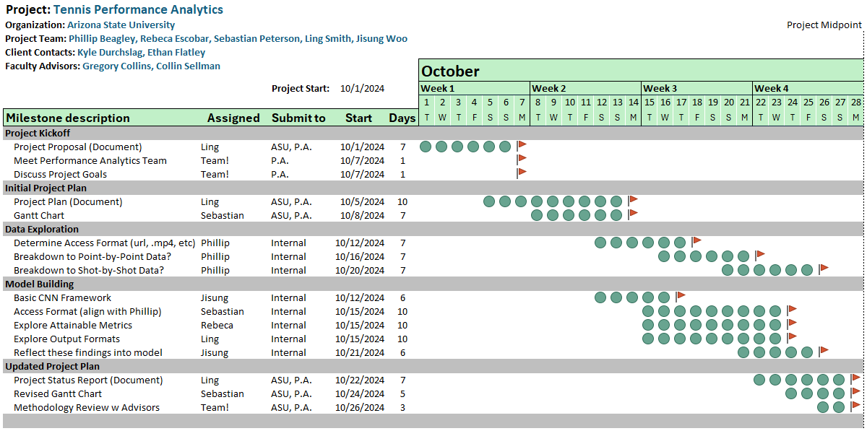
Early Milestones – Gantt Chart
As we progressed through the first four weeks

Slide 7
Project & Scope Alignment
After midpoint reviews with sponsors & advisors
Explore Existing Models & Applications
Pre-training
Transfer Learning
Other Model Types
Revised Project Plans
Define specific video-analysis tools to develop:
Boundary Overlay
Object Identification
Ball Tracking
Attempt fine-tuning on simple 3-minute clip from key baseline view
This led to redefining our ultimate “Step One”…

Slide 8
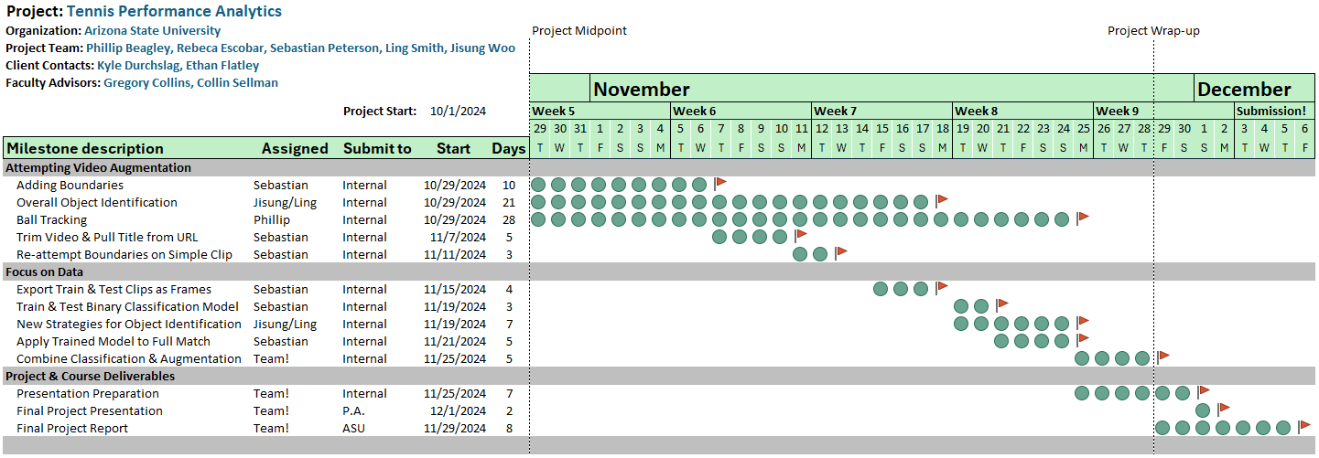
Project & Scope Alignment – Gantt Chart
After midpoint reviews with sponsors & advisors

Slide 9
LET’S GET TO THE RESULTS!

Slide 10
Results: Data Preparation
Redefining “Step One”
Discussed fine-tuning our advanced models by using a simple 3-minute demo from ONLY the baseline view
This would drastically speed up our development, but leaves one key challenge…
What good is the model, if it can only be applied to a pre-trimmed video?
Step One: We must first prepare the data!
Trimmed Match Video:
Realized that ALL vital “in-play” footage occurred from the key baseline view
Let’s build a CNN Model that can classify each frame as Class_0 or Class_1, and dispose any frame that is identified as Class_0!
Trained a model and built one Jupyter Notebook that can take a match URL, and output a trimmed video containing ONLY the video time from the essential baseline view!
This also allows for better & easier Video Augmentation…

Slide 11
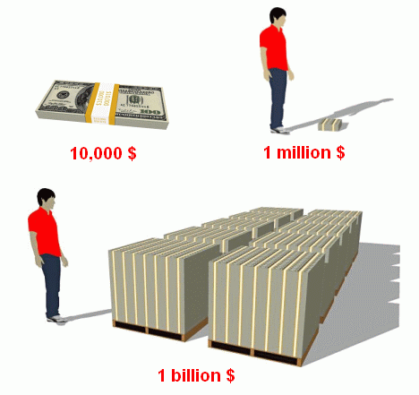
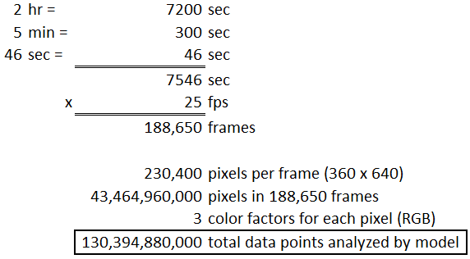
Results: Data Preparation
Demonstration of Model & Output
Live Demonstration of this Trained Model, and it’s use to trim full-length match videos…
Quantifying Data:

Slide 12
Results: Video Augmentation
Utilizing YOLOv8 Pretrained Model
Object Detection Approach
Challenge: Time constraints limited the ability to manually annotate large datasets for training and testing.
Solution: Leveraged the YOLOv8 pretrained model for object detection, utilizing its ability to identify objects in video frames without the need for extensive custom annotations.
Fine-Tuning YOLOv8
Focus Areas: Fine-tuned the pretrained model to specifically detect key objects in tennis match videos: persons (players), ball, and tennis racket.
Outcome: Achieved accurate detection of these critical elements in real-time match footage
Key Benefit
Quick Deployment: Pretrained model reduced setup time, enabling rapid integration into match analysis workflows.

Slide 13
Results: Video Augmentation
Demonstration of Model & Output
Demonstration of YOLOv8 Model
Identify key components in the video: players, ball, and racket, isolating relevant objects for further performance analysis.
This allows us to track the ball's speed through each frame in the match.
Ball Speed Measurement
Significance: Ball speed is a key indicator of player performance and match intensity.
On-Screen Tracking: Ball speed is shown as part of the video output, helping analysts visualize the intensity of each shot.
CSV File for Further Analysis: Ball speed data is saved in a CSV file, providing quantitative information that can be reviewed later for performance optimization.

Slide 14
Business Insights & Next Steps
Where does this go from here?
Now have tools to trim full-length match videos to one key view
PLUS: The baseline model for object identification & tracking
Next Steps...
Improve Upon Object Identification (focus on players, ball, and rackets)
Add in Boundary Overlay (should be much easier from single viewpoint)
Start determining actual insights to be discovered!
Considerations
Remember the “Quantifying Data” example…
Many of these models to follow will require MANY hours to train & run, or incredible computing capacity…

Slide 15
Business Insights & Next Steps
Where does this go from here?
Quantifying Data (Reminder)
Applying the model to trim just ONE tennis match required:
Analyzing more than 130 Billion data points
Approximately 12 hours to run
The ATP Livestream page contains more than 59,000 events
Just trimming the ~ 20,000 Men’s Singles matches would require:
Analyzing more than 2.6 QUADRILLION data points
Approximately 10,000 days (more than 27 years)
So, considerations:
As we did with this project, focus on working efficient!
Explore options for outsourcing next steps…

Slide 16
THANK YOU

